Slide 1


Computacenter
Making Digital Work

Slide 2
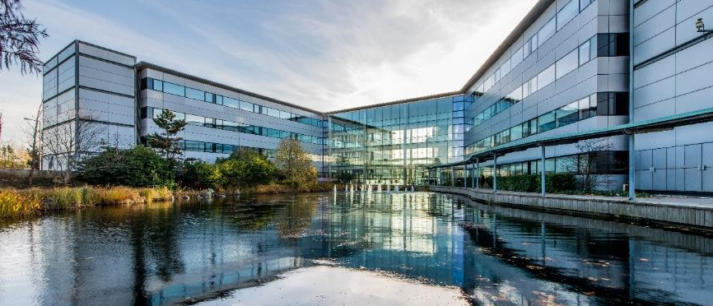
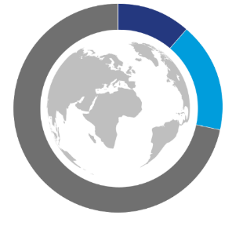
Computacenter Overview
FINANCIAL STRENGTH & STABILITY
LISTED COMPANY SINCE 1998; UNITED KINGDOM FTSE 250
NET FUNDS NO NET DEBT
$6B
Total Revenue
(FY2018 + estimates)
4.5B Technology Sourcing
$938M Managed Services
$142M Profit before Tax
$562M Professional Services
SCALE & RESOURCES
Group Headquarters - Hatfield, United Kingdom
4,200 Engineers
1,600 PMs & SMs
15,000 People
4,000 Service Center Staff
800 Consultants
BREADTH OF SKILLS
END USER
DATA & ANALYTICS
CLOUD & DATACENTER
NETWORKING
SECURITY
WORLDWIDE REACH & CUSTOMER FOCUS
We sell to customers in 8 countries
Technology Sourcing
We source, transform & manage technology for our customers in 70 countries worldwide
UK | Ireland | Germany | France | Belgium | Switzerland | Netherlands | USA
IT Strategy & Advisory Services
We also have operations/entities in another 12 countries
Design & Build Services
Hungary | Poland | India | Mexico | China | Spain | Malaysia Japan | Australia | Hong Kong | Singapore | Canada
Integration & Migration Services
Support & Maintenance Services
We source for and support customers in another 50 countries
Managed Services

Slide 3
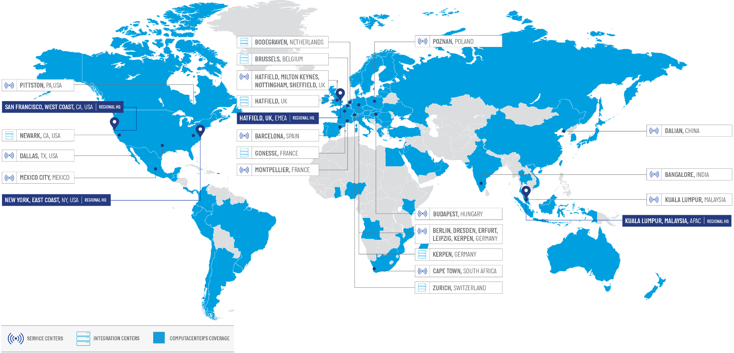
Our Worldwide Coverage
We source, transform & manage technology for our customers in 70 countries worldwide

Slide 4

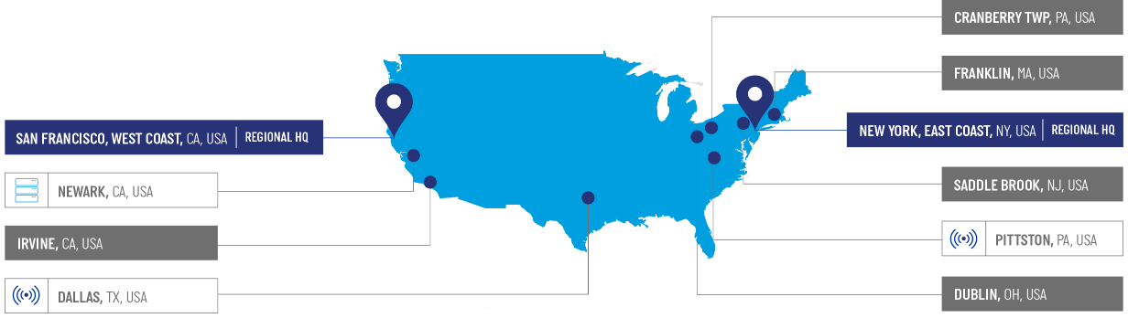
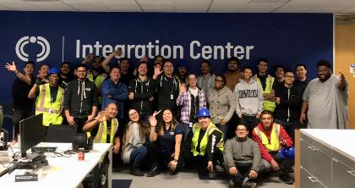
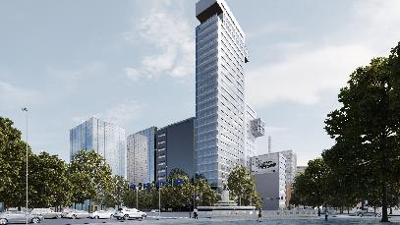
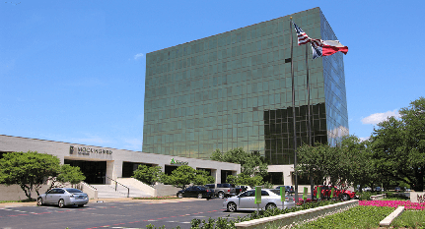
Computacenter US
Trusted international digital technology partner in the USA
Wholly owned by Computacenter Group, two entities: Computacenter US Inc. Fusionstorm Inc. (will be combined in 2020)
Managed Services operations established since 2005
Technology Sourcing heritage since 1995 from acquisition of Fusionstorm
Mexico City Service Center established in 2015 to support US customers
$1B+ TECH SOURCING REVENUE
$100M SERVICES REVENUE
$160M INVESTMENT BY COMPUTACENTER
700 US EMPLOYEES
200 dedicated partner staff
300 mexico employees
8 COUNTRIES WITH SITE SUPPORT IN AMERICAS
40 COUNTRIES SUPPLIED TO FROM NEWARK
3 AMERICAS IN AMERICAS WITH LEGAL ENTITIES
Integration Center – Newark, CA
Service Center - Mexico
Service Center - Dallas

Slide 5
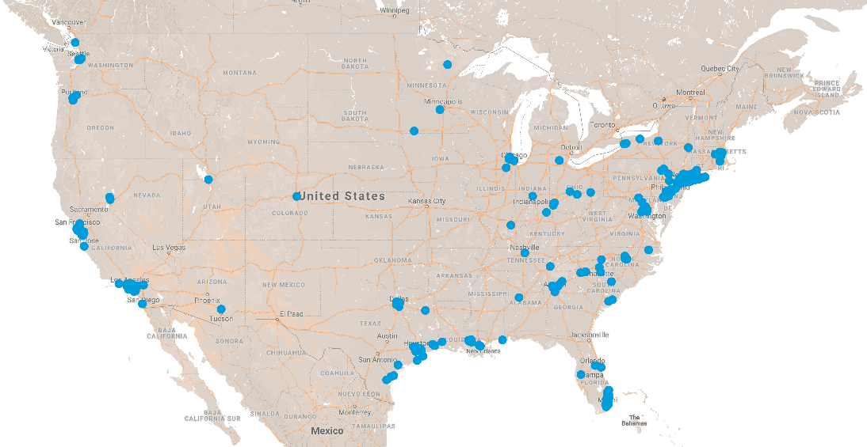
Computacenter Service Desk Coverage in the USA
Putting customers first
Local leadership engagement
End-to-end user support; locally and globally
High quality, multi-lingual service desk
‘Follow the sun’ or local 24x7 support
Three Regional Service Centers: Mexico City, Dallas TX, Pittston PA
600 EMPLOYED US TECHNICAL STAFF
300 mexico employees
200 dedicated partner staff
460 CUSTOMER LOCATIONS SUPPORTED
1.2m CONTACTS & REQUESTS PER YEAR
150 SITES WITH DEDICATED STAFF
40 US STATES WITH DEDICATED PEOPLE

Slide 6





































Powerful Partnerships We represent our customers – vendor independence
Leading Enterprise Partner
Global Enterprise & EMEA / US West Partner of the Year - 2018
1 of 8 global Titanium Black Partners
Synergy Partner of Choice EMEA -2018
Highest accredited - Personal Systems - Imaging & Printing
Leading Partner in workplace & data center
Globally, 3rd largest Windows migration partner
Partner of the Year EMEA - 2018
Gold Accreditation for Sales and Service
Leading global Partner
Computacenter holds over 200 vendor accreditations. Our staff hold over 20,000 vendor technical certifications.

Slide 7


Digital Innovation
Making Digital Work Better

Slide 8








Computacenter’s Response to Major Trends
Multi-Cloud becomes
the norm
Security risks become a business inhibitor
Shortage of talent
The shift
to digital
DIGITAL Innovation – Making Digital Work Better
Notes:
What we do.
At Computacenter we have long standing relationships with many of the worlds biggest organisations. These relationships allow us to see the challenges facing our customers on a day to day basis, and provide the insight needed to enable us to develop a portfolio of services that best meet our customers evolving needs. We’ve tailored our offering portfolios for workplace (DigitalMe), Security (DigitalTrust), Cloud (DigitalPower) and Networking (Digital Connect) to respond to the four main market trends that our customers are experiencing. The result is a comprehensive set of services that are al designed to “Make Digital Work” for our customers. Today we will be looking at one specific offering portfolio – DigitalTrust – to showcase how we at Computacenter can help our customers address not just these macro market trends but also issues that are specific to the security marketplace….

Slide 9

ElegantOps
Elegance delivers superior outcomes

Slide 10
DIGITAL Innovation
Transform
Programmatic frameworks and automation enable an increase in velocity while reducing risk.
Driving innovations that deliver superior, repeatable and measurable business outcomes, from efficient supply chain management, to increasing velocity while de-risking transformation, to next generation managed operations. DIGITAL Innovation enables DIGITAL Elegance.
Source
Manage
Portals, service catalogs, automated workflows,
metrics, KPIs, etc. are changing the face of the supply chain.
Iterative service quality improvements through instrumentation, metrics, automated action, and continuous improvement.
Notes:
Practice specific. How.
Digital Connect accelerates our clients’ digitalization journey through efficient technology acquisition, transformation and managed service expertise with innovation and global consistent delivery. Our solutions address every aspect of Enterprise Networking including Data Center, Campus & Edge networks, Wireless Networks and Hybrid WAN and enable connected business outcomes.
Our solutions address every aspect of Enterprise Networking including Data Center, Campus & Edge, Enterprise Mobility and Hybrid WAN.

Slide 11
DIGITAL Innovation Methodology
Focused on operational elegance and continuous improvement
Consult
Brew
Transform
Manage
Partner with our peers, customers and prospects to understand their challenges, ideate solutions and formulate epics and stories before moving to the brew stage.
Using the epics and stories we defined during the consult phase we will define the sprints required to prototype a solution.
Sprints should be short, typically two-weeks in length, long enough to get something effectuated, but short enough that we can stay agile, react to change and pivot as needed. In the brew phase we should deliver a prototype that clearly addresses the user story.
As a < type of user >, I want < some goal > so that < some reason >.
Move from the brew and prototype phase to production. True transformation requires committing to the endless journey of continuous improvement.
Computacenter drives continuous improvement though metrics and a mission to operate more elegantly today than we did yesterday.
1
2
3
4
Ideate
Formulate
Protype
Test
Review
Recalibrate
Iterate
Implement
Iterate
Operate, metric, iterate and improve.
Notes:
What?
Practice Methodology and Services

Slide 12


DIGITAL Innovation
Practice focus areas
Expert Services
Expert Services offerings focused on CRE, ElasticOps and DCIM continue to mature and grow. Expert Services is rooted in delivering ElegantOps. The DIGITAL Innovation GTM messaging focuses on elegance and long-term partnership; a culture of vitamins not painkillers.
Customer Reliability Engineering
Elastic Operations
Data Center Infrastructure Management (DCIM)
Expert Services
Having spent the last three (3) years platforming Expert Services on the ServiceNow ITSM platform, we have found that our experiences create a differentiated perspective and value proposition for our customers and prospects. Our approach to the ServiceNow market opportunity is rooted in how we have and continue to leverage the ServiceNow platform to achieve DIGITAL Elegance.
ServiceNow
Supply Chain for a Now Generation
ServiceNow ITSM and ITOM
Delivering ElegantOps on the Now platform
ServiceNow
Digital Innovation in the cloud focuses on helping customers truly move towards composable infrastructure or helping customer lift-and-shift workloads to the public cloud. Our cloud GTM strategy is tightly coupled with Expert Services Day 2 ElegantOps.
Enabling the Cloud
Cloud
Infrastructure-as-Code (IaC)
Public, private, hybrid, multi-cloud

Slide 13



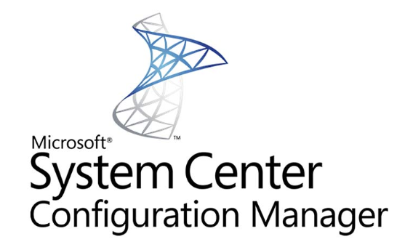































DIGITAL Elegance
DIGITAL
Innovation
Elegant execution should be indistinguishable from magic.
ElegantOps
ElegantOps

Slide 14

Supply Chain for a Now Generation
Because we believe DIGITAL Elegance should start on Day 0

Slide 15

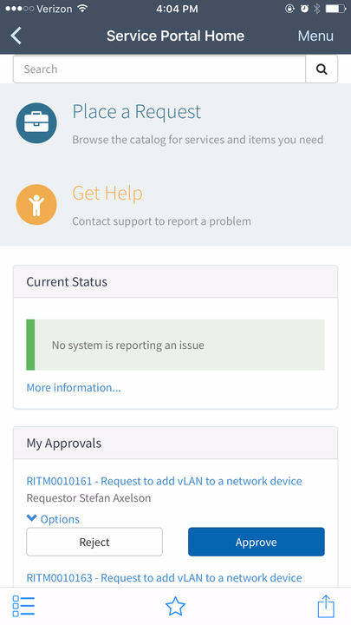
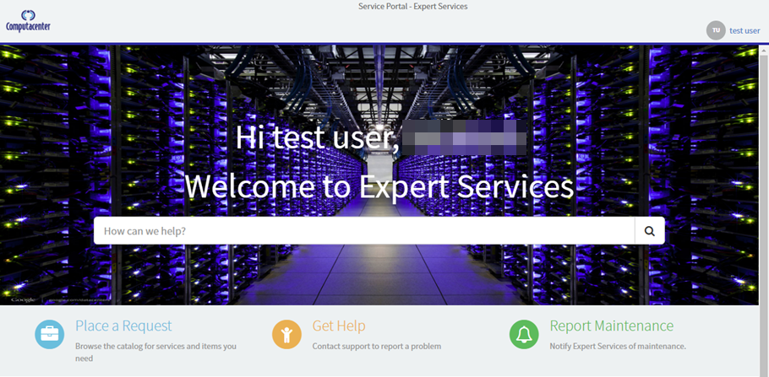



Service Portal
Service Portal: https://expertservices.service-now.com/sp
Email: expertservices@service-now.com
Mobile Application: ServiceNow

Slide 16
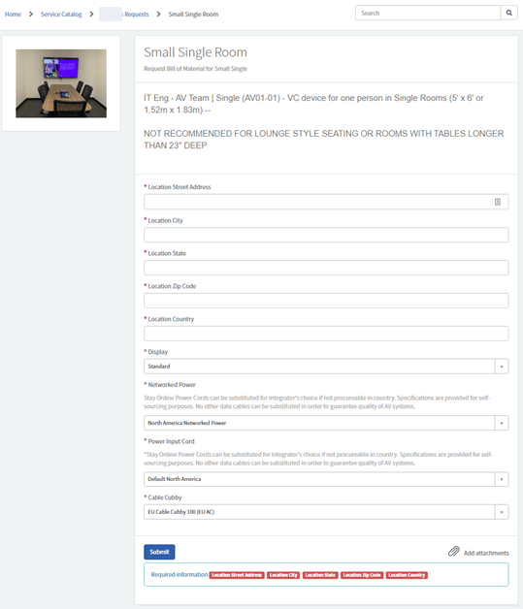
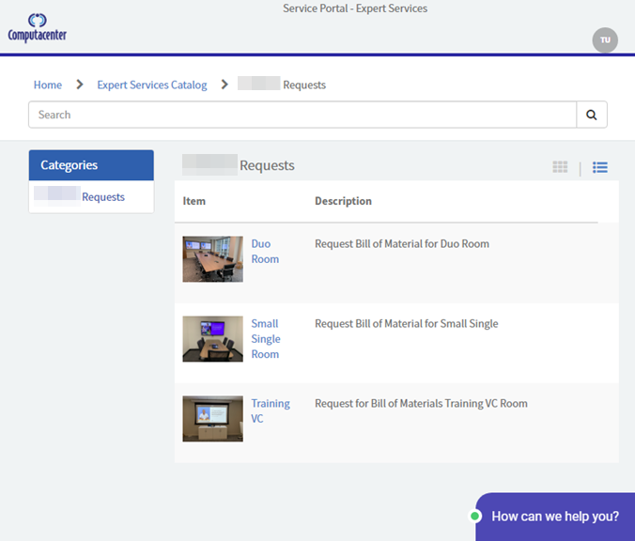
Service Catalog

Slide 17
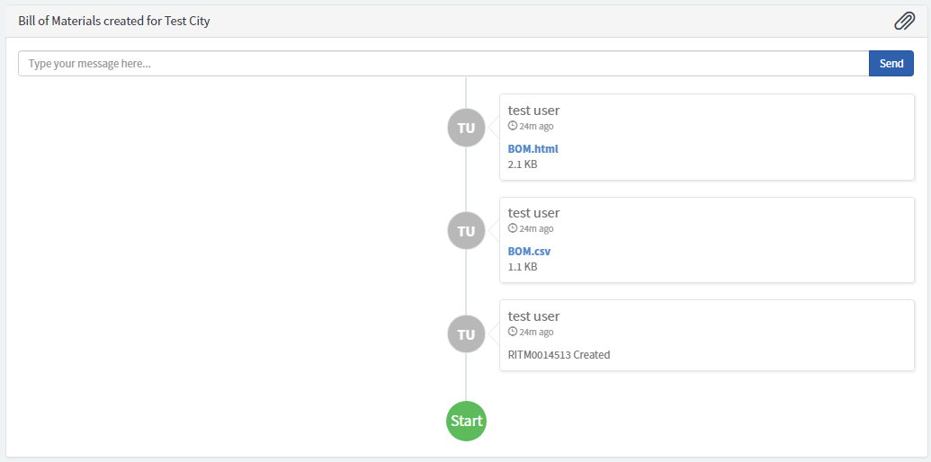
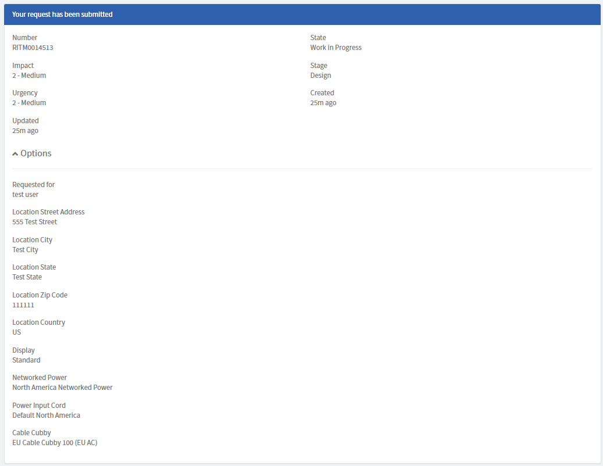
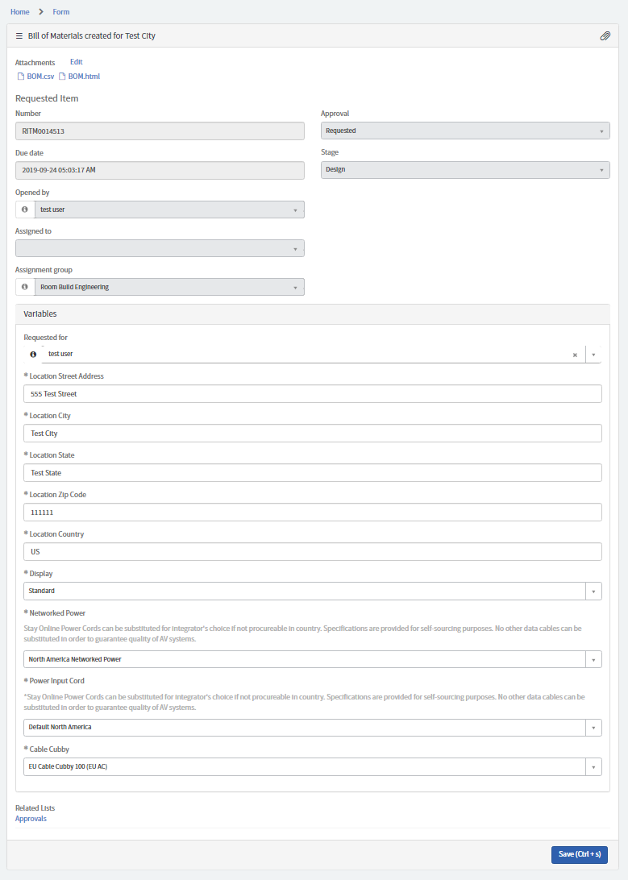
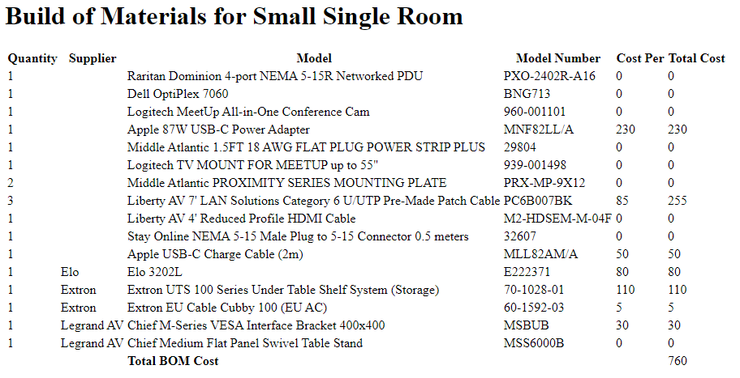
Request & BOM Creation User View

Slide 18
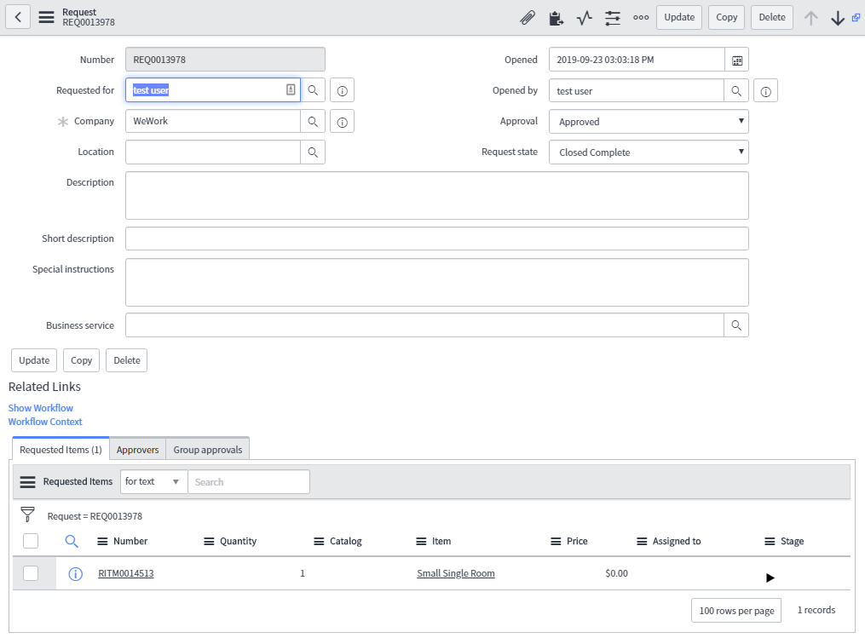
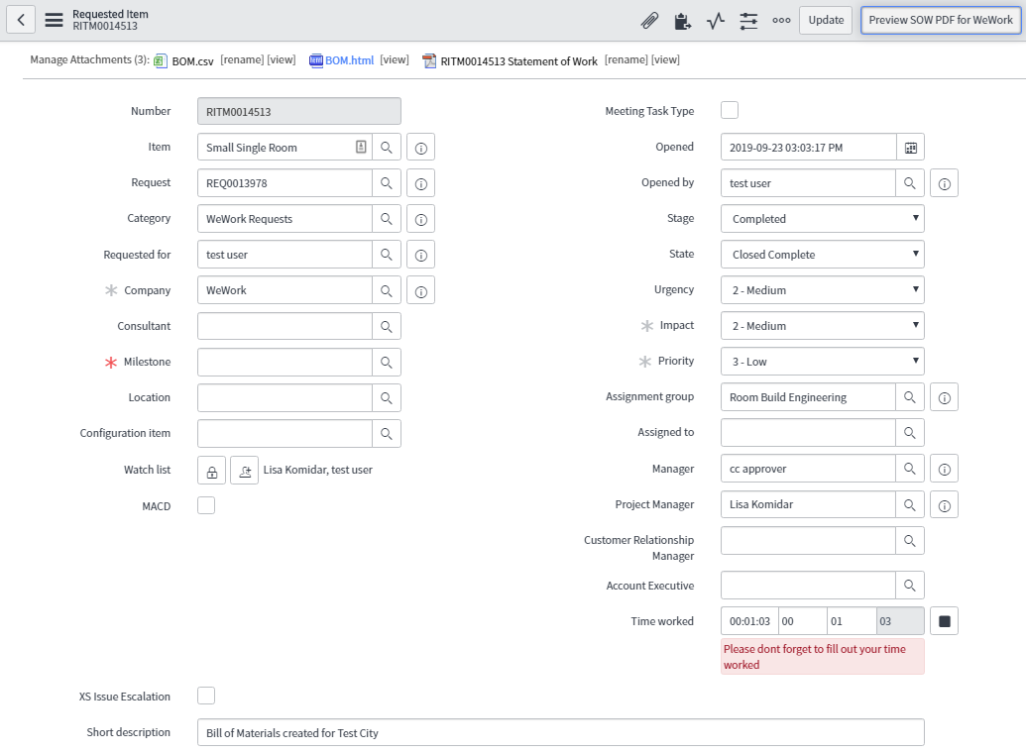
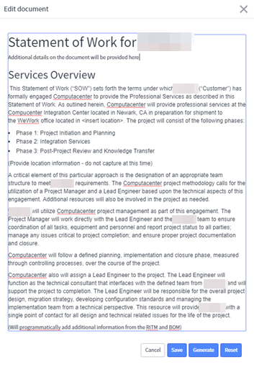
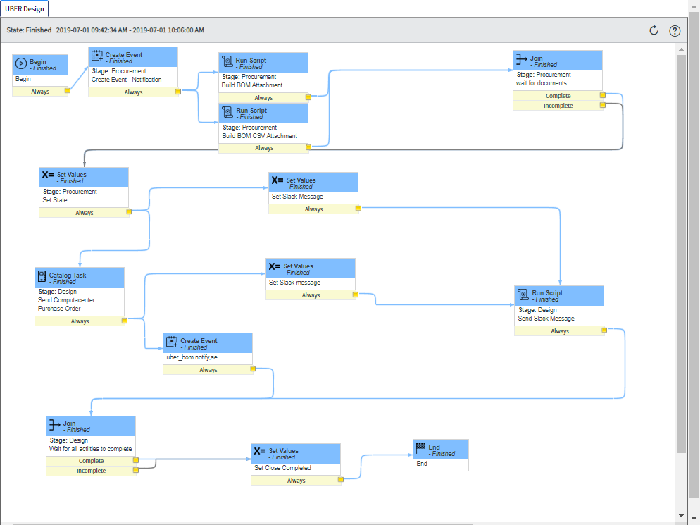
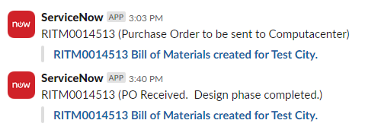
Request, BOM Creation, PO, ChatOps Notification

Slide 19
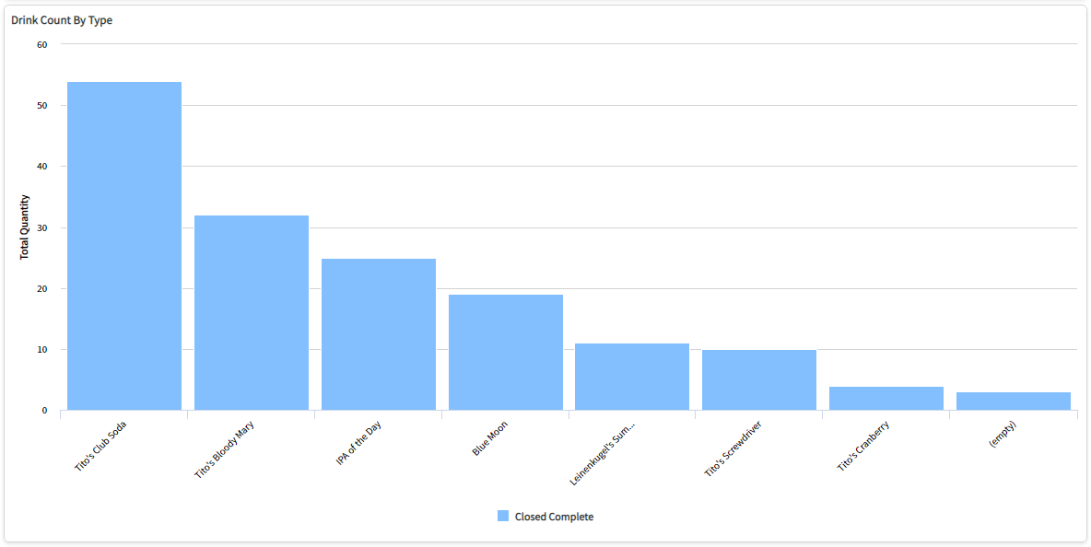
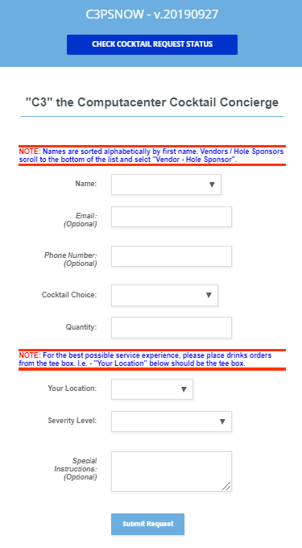
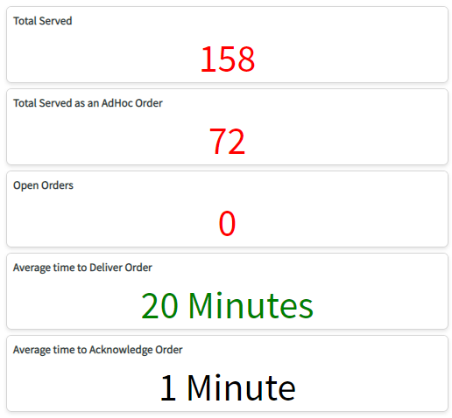
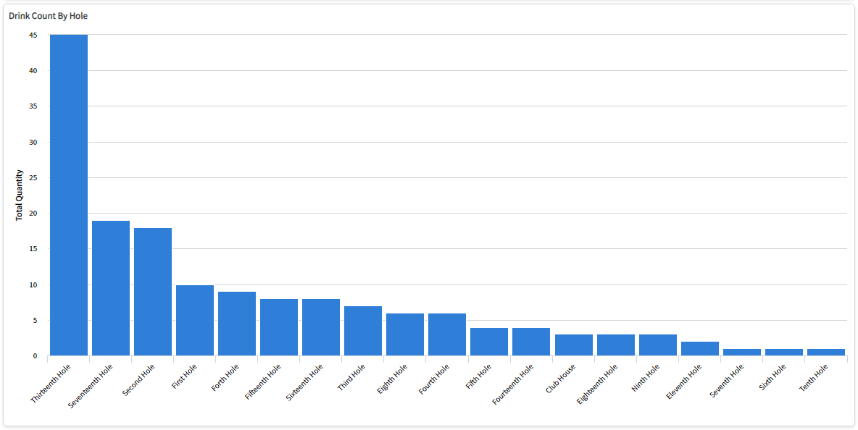
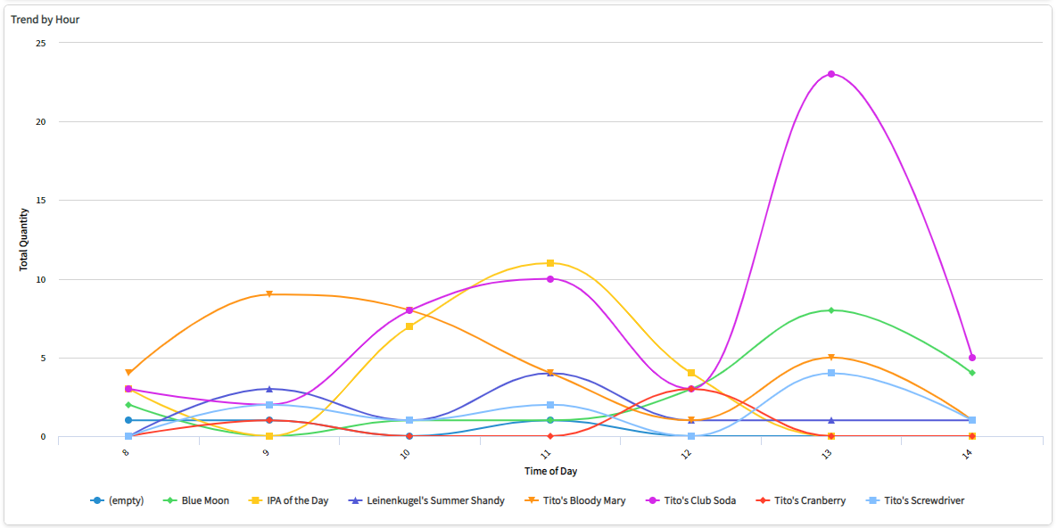
Process Rigor Drives KPIs

Slide 20
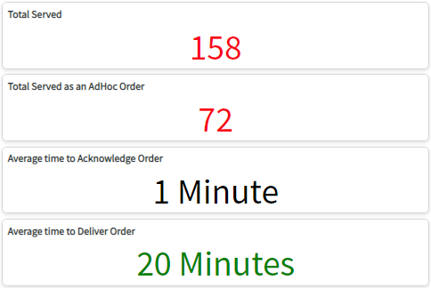
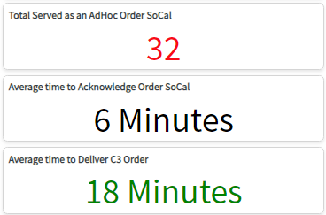
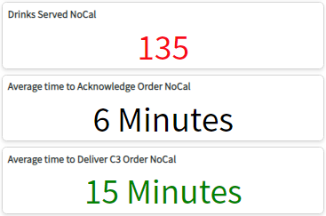
KPIs Drive Continuous Improvement
“Perfection is not attainable. But if we chase perfection, we can catch excellence.” - Vince Lombardi
CC NYC C3 KPIs
June 2019
CC SoCal C3 KPIs
September 2019
CC NorCal C3 KPIs
September 2019
Continuous Improvement
NYC → SoCal Improvements
Updated the UI to better direct users when placing cocktail orders.
Nearshored request ack and assignment.
Focused onshore resources on improving the process and MTTD (mean-time-to-delivery).
SoCal → NorCal Improvements
Alphabetize golfer names in UI by first name.
Denoted email, phone number and special instructions as optional fields.
Added real-time order status tracking.
Request reported as “Open” or “Out for Delivery”.
Added “Vendor – Hole Sponsor” requestor option.
Note: NYC vs SoCal & NorCal delivery methods were vastly different. NYC ad-hoc order stats represent orders we fulfilled on-demand and entered into the system on behalf of the consumer. In SoCal and NorCal we required that the app be used, no on-demand orders. NorCal received the most refined product, so it is expected that they also had the highest engagement the best user experience.

Slide 21
Contact Us
West of the Mississippi | Kevin Lewin Customer Acquisition Engineer Kevin.Lewin@Computacenter.com Cell: 530-401-7867
East of the Mississippi | Michelle Nazath Customer Acquisition Engineer Michelle Nazath@Computacenter.com Cell: 732-778-6390
Practice Director | Richard Bocchinfuso Digital Innovation, Practice Director Richard.Bocchinfuso@Computacenter.com Cell: 732-713-5671
THANK YOU

